Slide 1



Triggers and (De-)escalations:
Understanding Bullying Events From the Adolescents’ Perspective Using a Qualitative Meta-Analysis
Jana Fikrlová, Tereza Levková, Lenka Kollerová, Karolína Umová, Ivan Ropovik, Martina Klocková, Tomáš Lintner, Radek Rychlík, Adam Klocek
Institute of Psychology of the Czech Academy of Sciences, Brno, Czech Republic
Vilnius, Lithuania, 2025 August 28

Slide 2

Questions we (typically) ask when dealing with bullying: bullying as a „whodunnit“
Who was the victim? Who was the aggressor? What is wrong with them?
Who is responsible for dealing with bullying?
What has just happened?
See, e.g., Søndergaard (2014), for a similar discussion.

Slide 3



Questions we (typically) ask when dealing with bullying: bullying as a „whodunnit“
Teacher
Parents
Counsellor
Who was the victim? Who was the aggressor? What is wrong with them?
Who is responsible for dealing with bullying?
What has just happened?
Bully
Victim
See, e.g., Søndergaard (2014), for a similar discussion.

Slide 4
Questions we (typically) do not ask:
How has bullying progressed from its onset through escalation or maintenance to de-escalation?
See, e.g., Søndergaard (2014), for a similar discussion.

Slide 5
Existing systematic reviews and meta-analyses on bullying have primarily examined its prevalence, consequences, and the characteristics of bullies, victims, and bystanders (e.g., Ariani et al., 2025; Cook et al., 2010), but not bullying as a (group) process
Accumulating qualitative studies on adolescents‘ bullying experiences
Previous narrative synthesis of qualitative findings (e.g., Thornberg, 2011)
Need for a large-scale, systematic synthesis

Slide 6

Research question:
What types of events at the bullying onset, escalation, and de-escalation shape the progression of the bullying process within the school context in adolescence?

Slide 7
Method: Qualitative meta-analysis (Timulak, 2009; Timulak & Creaner, 2022)
= a meta-analysis of qualitative studies → synthesizing existing qualitative research in a systematic way
Increasingly applied in research on the process of psychotherapy to study its outcomes (Ladmanová et al., 2022, 2025), experiences (Vybíral et al., 2024), and events (Timulak, 2007)

Slide 8

Method
Scan for the full
PROSPERO
pre-registration!
PRISMA guidelines (Moher et al., 2009)
PROSPERO pre-registration
Databases: WoS, SCOPUS, EBSCO (e.g., PsycINFO, PsycArticles)
Search string: refined from keywords in 70 meta-analyses on bullying in adolescence
Two-stage process:
Abstract screening,
Full-text screening & data extraction
ASReview (first stage): 2 reviewers screened 600 most relevant studies (Naïve Bayes ML algorithm classification)
Eligibility criteria: (1) English, (2) Not a duplicate, (3) Bullying/Victimization focus, (4) Qualitative empirical study, (5) School setting, and (6) Adolescent population
LLM-based abstract screening compared to human-screening (93.1 % agreement)
Full-text screening (second stage): studies divided between 8 reviewers and data extracted using MAXQDA (VERBI software, 2020)

Slide 9
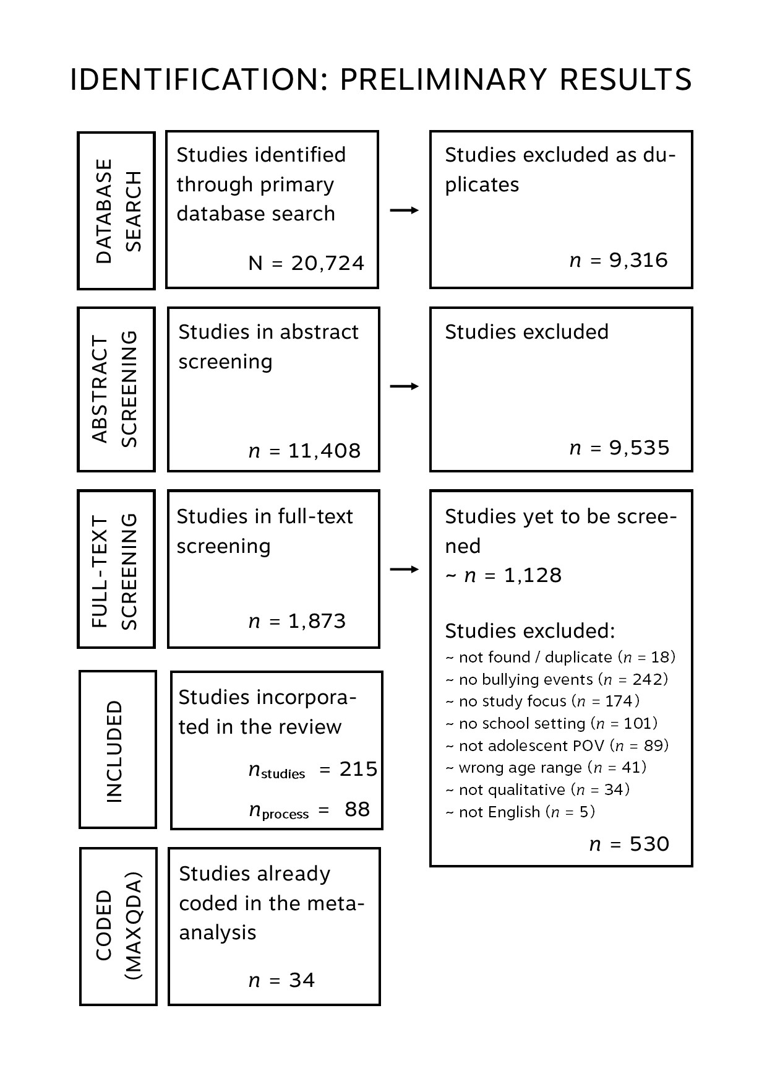

Slide 10
Description of the Selected Studies
Sample size: 1159 participants; M(SD)= 36(43); Mdn = 20
Age participants: M(SD) = 12.93(2.47); Mdn = 14; range from 9.95 to 16.14 years
Gender of the participants: M(SD) = 44(28) %; Mdn = 52 %
Specific populations: minority ethnicity, gifted, immigrants, LGBTQ+ minority gender
Country sample: US (n = 6), SE (n = 5), GB (n = 2), AU (n = 2), MY (n = 2), IT (n = 2), other (e.g., CA, CN, CZ, NL, DK, EE, KR, DE, TH, FI, IN, JP)
Data collection method: interviews (n = 25), focus groups (n = 5), narratives (n = 1), open text fields in surveys (n = 3)
Data analysis method: thematic or content analysis (n = 11), grounded theory (n = 4), IPA (n = 5), discourse analysis (n = 2), other approaches (n = 12)

Slide 11
Method: Qualitative meta-analysis (Timulak, 2009; Timulak & Creaner, 2022)
34 studies with highlighted bullying process excerpts
Coding meaning units (e.g., phrases, sentences or short paragraphs containing a meaning relevant to the research question) about bullying events
Sorting codes into 4 pre-defined domains of investigation: (1) onset, (2) escalation, (3) maintenance, (4) de-escalation
Categorising meaning units based on similarity into meta-categories
Hierarchically structuring the meta-categories into clusters

Slide 12
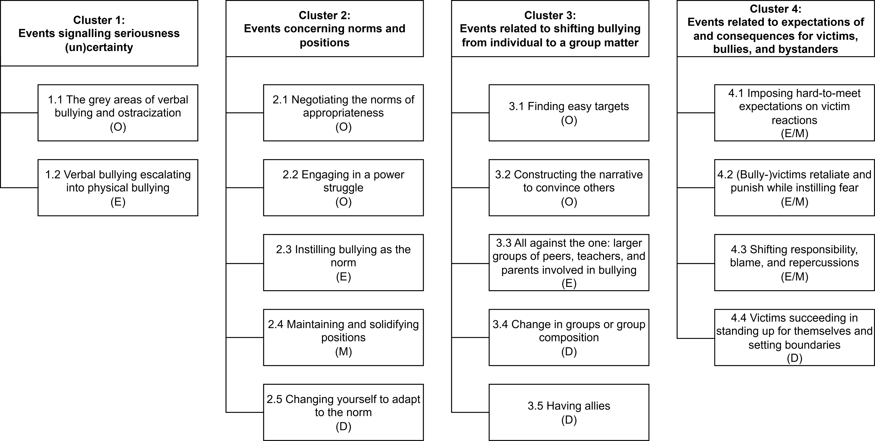
Fig. 1: A structural diagram of clusters and meta-categories

Slide 13
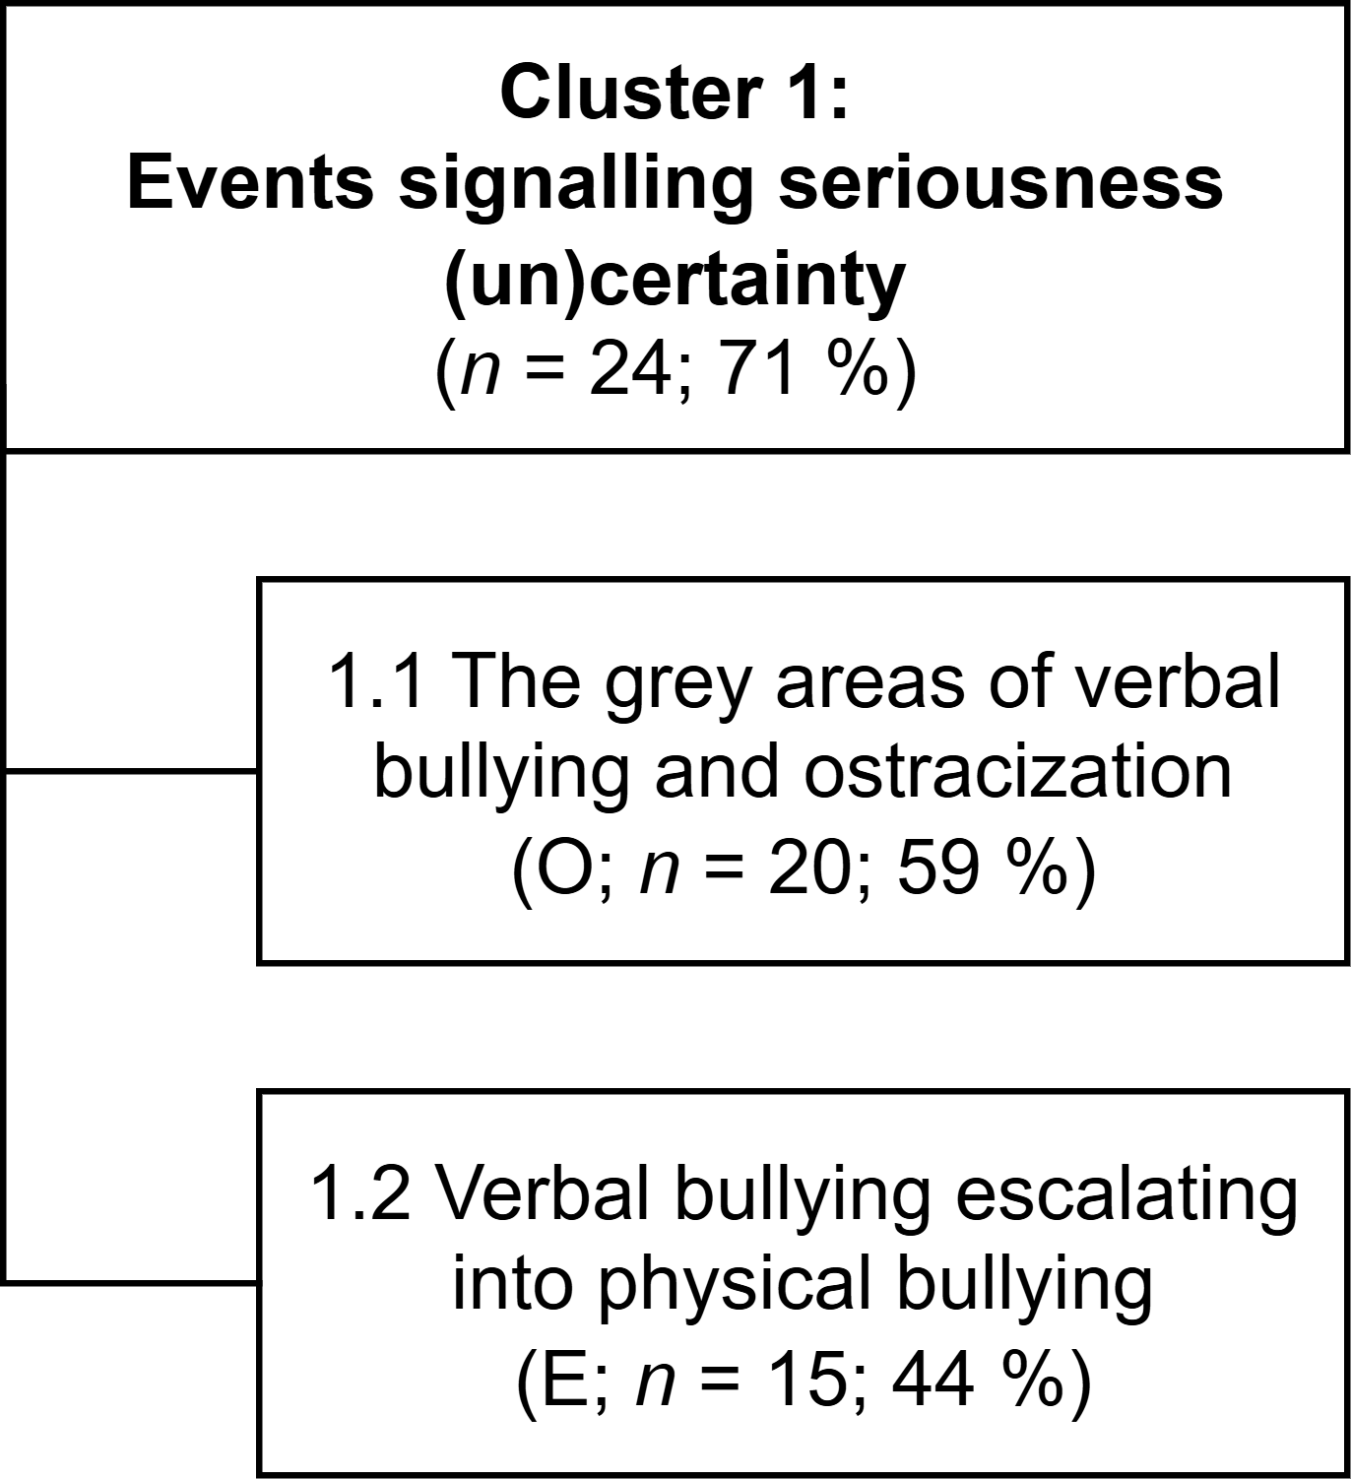
„Grey areas“ = „low-level bullying“ (Thornberg, 2011)
Verbal bullying (e.g., teasing)
Ostracization, but only for bystanders and teachers, not victims or bullies
Bullying escalates from verbal into physical mainly when…
bullies escalate their aggression towards the victims,
victims physically retaliate (reactive aggression).
Low certainty about the seriousness of verbal, but high certainty about the seriousness of physical bullying.
O
E
M
D
= ONSET = ESCALATION = MAINTENANCE = DE-ESCALATION

Slide 14
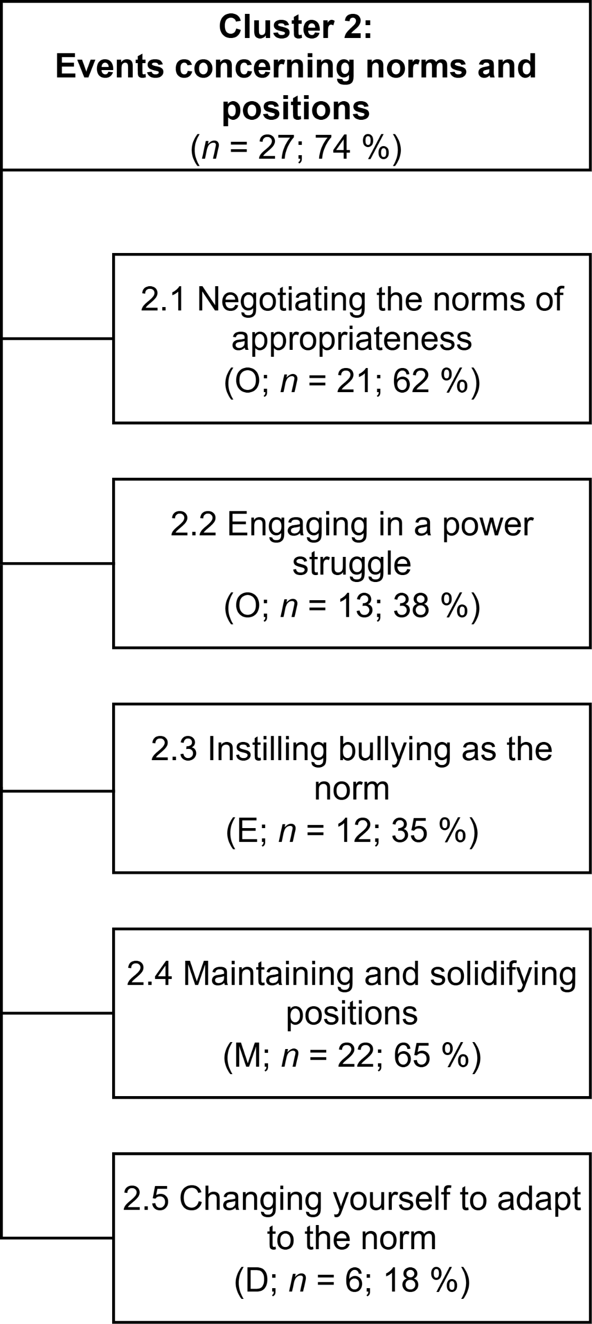
Negotiating the norms of what is „appropriate“ / „normal“ / „desirable“
Constructing inferior and superior groups (e.g., „thin vs. overweight“, „sporty vs. non-sporty“)
Teachers and didactic setting fostering the context for humiliation
Engaging in a power struggle
Bullying to achieve the status needed to impact the norms
Normalising bullying („it‘s just a friend thing“) and condemning defending
→ norms where popularity is associated with aggression (Laninga-Wijnen et al., 2017; Laninga-Wijnen & Veenstra, 2021)
Notes:
Norma popularity

Slide 15
Targeting the same victims, often using ritualised means
E.g., routinely blocking the bathroom door and beating up the same victim
Bullying in the form of a „social ritual“ (Davies, 2011)
Victims locked in their victimised position
Victim‘s reactions are used to justify and/or escalate / maintain bullying
Victim accepting and identifying with the unfavourable position
Changing yourself to fit the norm
A highly risky strategy
→ victims are often excluded from negotiating the norms
„Trapped“ in the victimised position (Thornberg, 2015)
Notes:
Norma popularity

Slide 16
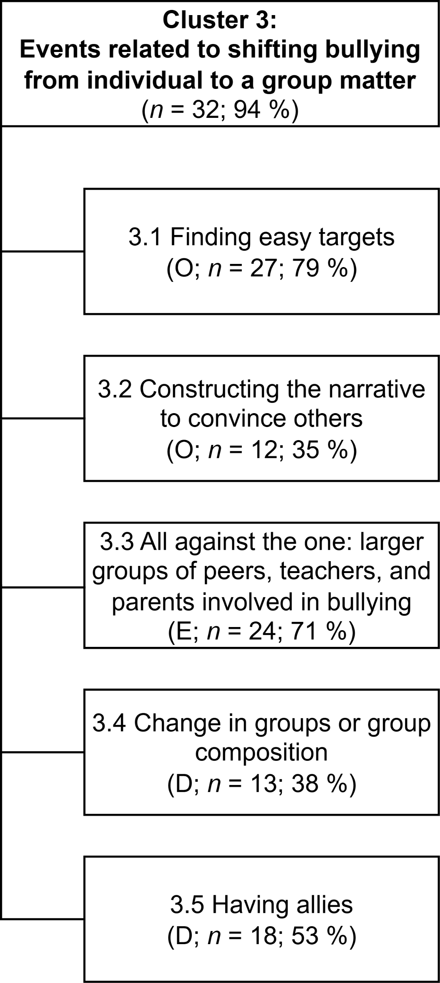
Targeting peers who are „disturbingly different“ / „weak“
Constructing the narrative about targeted individuals → spreading (false) accusations, sowing doubts
Bullies draw others to their side and isolate / ostracize the victim
Bullies form groups (e.g., bullying hierarchies)
Bystanders join in or verbally encourage bullying → larger groups or the whole class engages in bullying
Teachers and school staff engage in bullying (e.g., laughing along with the bullies)
→ the influence-compatibility model (Laursen & Veenstra, 2021)
→ the healthy context paradox (Laninga-Wijnen et al., 2025)
→ bullying as a group process (Salmivalli, 2010)

Slide 17
Change in groups or group composition
Finding new friendship groups in or outside of class or the group of bullies falling apart (e.g., due to a newcomer)
Having allies
Friends, bystanders, or teachers who are willing to defend, support, or at least acknowledge / not exclude the victim
→ broader perspective on defending

Slide 18
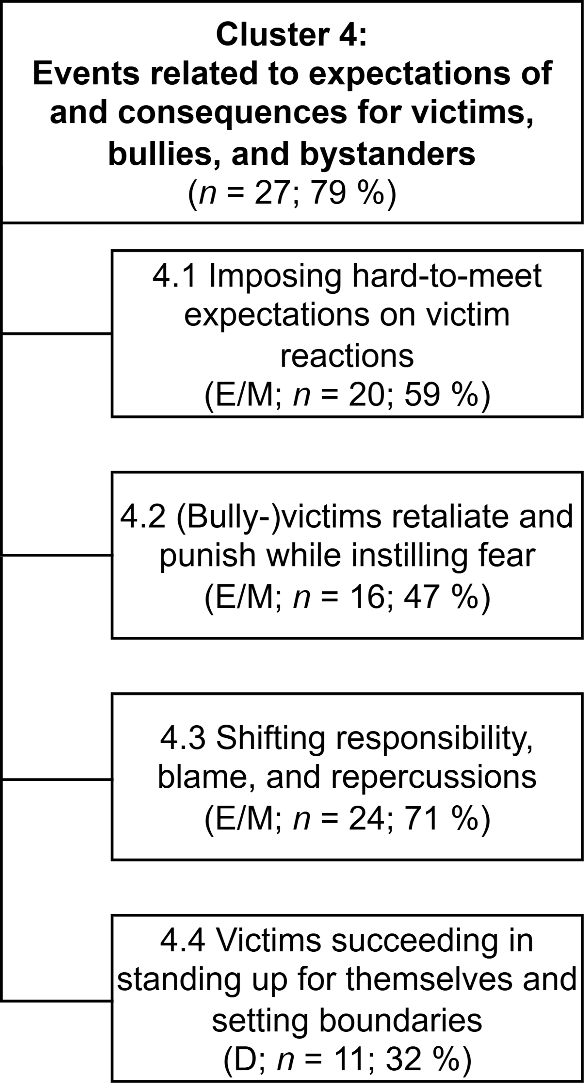
Expectations about how real victims should react
Victims are expected to react non-aggressively (often counterproductive)
Loss of victim status after reactive aggression in the eyes of adults
(Bully-)victims retaliate and punish signs of resistance that might endanger their status
Aggressive victims
Also serves to instil the fear of retaliation
suppressing defending, questioning of their behaviour, or the established norms

Slide 19
Shifting responsibility, blame, and repercussions from bullies to victims
Victim blaming
Bullies evading punishment (e.g., convincing teachers that they are the real victims)
Victims labelled as the „problem“ by teachers and parents
Lack of negative consequences for bullies → e.g., teachers and parents „talking with the bully“, but without measures
social learning: reward structures where bullying „pays off“ (e.g., Volk et al., 2012)

Slide 20
Victims de-escalate the bullying by successfully standing up for themselves
Immediate reactions (also to the „grey areas“)
However, highly dependent on victim‘s and bully‘s relative status

Slide 21
CONCLUSIONS
ONSET
ESCALATION
Bullying as „aggressive behaviour or intentional harm doing that is carried out repeatedly and over time in an interpersonal relationship characterized by an actual or perceived imbalance of power or strength“
(Olweus & Limber, 2010, p. 125)
MAINTENANCE
DE-ESCALATION

Slide 22
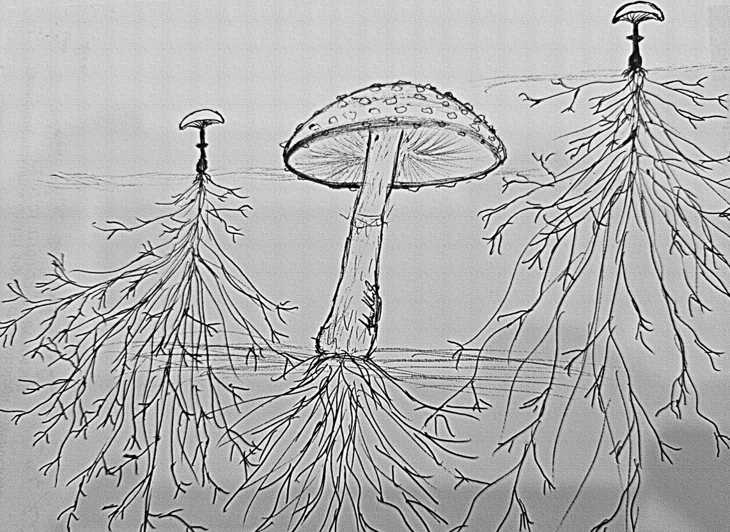
CONCLUSIONS
Bully-victim hitting the bully
The „grey areas“
Typically focusing on visible, typically physical bullying behaviour
However, many less noticeable behaviours that „prepare the ground“ for bullying take place before such incidents
= the power imbalance is also actively constructed, not only exploited
Power struggle
Negotiating the norms of appropriateness
Constructing the narrative to convince others
Reward structure favouring bullying

Slide 23
CONCLUSIONS
Events with potential for both escalation and de-escalation
retaliation
changing yourself to adapt to the (popularity) norm
defending
= dependent on social status, bullying phase/progression…
De-escalation is not always unequivocally positive and often comes with costs (e.g., changing schools)
not losing sight of victims after de-escalation

Slide 24


Thank you for listening!
Jana Fikrlová, Tereza Levková, Lenka Kollerová, Adam Klocek, Tomáš Lintner, Karolína Umová, Ivan Ropovik, Radek Rychlík, Karolína Umová, Martina Klocková
E-mail: fikrlova@fss.muni.cz
Institute of Psychology of the Czech Academy of Sciences, Brno, Czech Republic
This research was supported by the Czech Science Foundation, under the standard project program with the reference number of GA25-15697S.

Slide 25
REFERENCES
Ariani, T. A., Putri, A. R., Firdausi, F. A., & Aini, N. (2025). Global prevalence and psychological impact of bullying among children and adolescents: A meta-analysis. Journal of Affective Disorders, 385, 119446. https://doi.org/10.1016/j.jad.2025.119446
Cook, C. R., Williams, K. R., Guerra, N. G., Kim, T. E., & Sadek, S. (2010). Predictors of bullying and victimization in childhood and adolescence: A meta-analytic investigation. School Psychology Quarterly, 25(2), 65–83. https://doi.org/10.1037/a0020149
Davies, B. (2011). Bullies as guardians of the moral order or an ethic of truths? Children & Society, 25(4), 278–286. https://doi.org/10.1111/j.1099-0860.2011.00380.x
Ladmanová, M., Řiháček, T., & Timulak, L. (2022). Client-Identified Impacts of Helpful and Hindering Events in Psychotherapy: A Qualitative Meta-analysis. Psychotherapy Research, 32(6), 723–735. https://doi.org/10.1080/10503307.2021.2003885
Ladmanová, M., Řiháček, T., Timulak, L., Jonášová, K., Kubantová, B., Mikoška, P., Polakovská, L., & Elliott, R. (2025). Client-identified outcomes of individual psychotherapy: A qualitative meta-analysis. The Lancet Psychiatry, 12(1), 18–31. https://doi.org/10.1016/S2215-0366(24)00356-0
Laninga-Wijnen, L., Harakeh, Z., Steglich, C., Dijkstra, J. K., Veenstra, R., & Vollebergh, W. (2017). The norms of popular peers moderate friendship dynamics of adolescent aggression. Child Development, 88(4), 1265–1283. https://doi.org/10.1111/cdev.12650
Laninga-Wijnen, L., & Veenstra, R. (2021). Peer similarity in adolescent social networks: Types of selection and influence, and factors contributing to openness to peer influence. In B. Halpern-Felsher (Ed.), Encyclopedia of Child and Adolescent Health: Vol. 3. Social and Environmental Influences (pp. 196–206). Elsevier.
Laninga-Wijnen, L., Yanagida, T., Garandeau, C. F., Malamut, S. T., Veenstra, R., & Salmivalli, C. (2025). Is there really a healthy context paradox for victims of bullying? A longitudinal test of bidirectional within-and between-person associations between victimization and psychological problems. Development and Psychopathology, 37(1), 40–54. https://doi.org/10.1017/S0954579423001384

Slide 26
REFERENCES
Laursen, B., & Veenstra, R. (2021). Toward understanding the functions of peer influence: A summary and synthesis of recent empirical research. Journal of Research on Adolescence, 31(4), 889–907. https://doi.org/10.1111/jora.12606
Moher, D., Liberati, A., Tetzlaff, J., Altman, D. G., & Group, T. P. (2009). Preferred reporting items for systematic reviews and meta-analyses: the PRISMA Statement. PLOS Medicine, 6(7), e1000097. https://doi.org/10.1371/journal.pmed.1000097
Olweus, D., & Limber, S. P. (2010). Bullying in school: Evaluation and dissemination of the Olweus Bullying Prevention Program. American Journal of Orthopsychiatry, 80(1), 124–134. https://doi.org/10.1111/j.1939-0025.2010.01015.x
Salmivalli, C. (2010). Bullying and the peer group: A review. Aggression and Violent Behavior, 15(2), 112–120. https://doi.org/10.1016/j.avb.2009.08.007
Søndergaard, D. M. (2014). Social exclusion anxiety: Bullying and the forcesthat contribute to bullying amongst children at school. In D. M. Søndergaard & R. M. Schott (Eds.), School Bullying: New Theories in Context (pp. 47–80). Cambridge University Press. https://doi.org/10.1017/CBO9781139226707.005
Thornberg, R. (2011). ‘She’s weird!’— The social construction of bullying in school: a review of qualitative research. Children & Society, 25(4), 258–267. https://doi.org/10.1111/j.1099-0860.2011.00374.x
Thornberg, R. (2015). School bullying as a collective action: stigma processes and identity struggling. Children & Society, 29(4), 310–320. https://doi.org/10.1111/chso.12058
Timulak, L. (2007). Identifying core categories of client-identified impact of helpful events in psychotherapy: A qualitative meta-analysis. Psychotherapy Research, 17(3), 305–314. https://doi.org/10.1080/10503300600608116

Slide 27
REFERENCES
Timulak, L. (2009). Meta-analysis of qualitative studies: A tool for reviewing qualitative research findings in psychotherapy. Psychotherapy Research, 19(4–5), 591–600. https://doi.org/10.1080/10503300802477989
Timulak, L., & Creaner, M. (2022). Essentials of qualitative meta-analysis. American Psychological Association.
VERBI Software. (2020). MAXQDA 2020 [Computer software]. VERBI Software. https://www.maxqda.com/
Volk, A. A., Camilleri, J. A., Dane, A. V., & Marini, Z. A. (2012). Is adolescent bullying an evolutionary adaptation? Aggressive Behavior, 38(3), 222–238. https://doi.org/10.1002/ab.21418
Vybíral, Z., Ogles, B. M., Řiháček, T., Urbancová, B., & Gocieková, V. (2024). Negative experiences in psychotherapy from clients’ perspective: A qualitative meta-analysis. Psychotherapy Research, 34(3), 279–292. https://doi.org/10.1080/10503307.2023.2226813

Slide 28
Clusters & Meta-categories | n (%) | Descriptions | Illustrative Quotes
Cluster 1: Events signalling seriousness (un)certainty | 24 (71 %)
The grey areas of verbal bullying and ostracisation | 20 (59 %) | Reluctance to label verbal aggressions (e.g., teasing) as bullying. Ostracisation is unclear for bystanders and adults but not victims. | „…but if it‘s just a small one, like someone saying something mean, then maybe not so much happens.“ Forsberg et al. (2014).
Verbal bullying escalating into physical bullying | 15 (44 %) | Grey areas escalate into physical bullying (on part of the bully or victim). | „A boy made her angry when he said she ‚couldn’t read‘. She responded violently when she ‚got him up to wall‘.“ Nassem (2017).

Slide 29
Clusters & Meta-categories | n (%) | Descriptions | Illustrative Quotes
Cluster 2: Events concerning norms and positions | 27 (74 %)
Negotiating the norms of appropriateness | 21 (62 %) | Negotiating „appropriateness“ and high- and low-status groups. Teachers and didactic setting contributing to the conditions for norm negotiation. | „…those who were regarded as thin always teased those who were fat.“ Hlophe et al. (2017).
Engaging in a power struggle | 13 (38 %) | Starting bullying incidents to gain power to negotiate the norms in class. | „…bullying is just a way that they try to win and be the top, and be on the top.“ Nelson et al. (2019).

Slide 30
Clusters & Meta-categories | n (%) | Descriptions | Illustrative Quotes
Cluster 2: Events concerning norms and positions | 27 (74 %)
Instilling bullying as the norm | 12 (35 %) | Normalising bullying and downplaiyng its seriousness while problematising defending. | „‘Like every once in a while we might bully each other, but it‘s just a friend thing‘.“ Adamshick (2010).
Maintaining and solidifying positions | 22 (65 %) | Bullies target the same victims in similar ways to maintain status. Victims are locked in the victimised position. | „‘I can‘t even count the number of times that I‘ve been made fun of because I‘m the bigger kid in the class. I‘ve been told I need bra to support my man boobs.‘“ Jachyra (2016).

Slide 31
Clusters & Meta-categories | n (%) | Descriptions | Illustrative Quotes
Cluster 2: Events concerning norms and positions | 27 (74 %)
Changing yourself to adapt to the norm | 6 (18 %) | Changing one‘s behaviour, appearance, or attitudes to fit the norm of at least one of the peer groups. However, victims are often excluded from trying to fit in/renegotiate the popularity norms. | „Lily joined in the explicit assessments of Olivia as ‚insanely irritating‘ and ‚just so different from us‘.“ Søndergaard (2011).

Slide 32
Clusters & Meta-categories | n (%) | Descriptions | Illustrative Quotes
Cluster 3: Events related to shifting bullying from individual to group matter | 32 (94 %)
Findings easy targets | 27 (79 %) | Identifying and targeting peers who are „disturbingly different“ or peceived as weak. | „Kaija added that a student can be excluded if they are ‚disturbingly different‘.“ Juva (2020).
Constructing the narrative to convince others | 12 (35 %) | Spreading (false) accusations to construct the narrative about the victim(s) as unfavourable or problematic. | „‘Well, I am not sure, but they said a lot of bad things about her… like she was ‚selfish‘ and never listened to people.‘“ Akiba (2004).

Slide 33
Clusters & Meta-categories | n (%) | Descriptions | Illustrative Quotes
Cluster 3: Events related to shifting bullying from individual to group matter | 32 (94 %)
All against the one: larger groups of peers, teachers and parents getting involved in bullying | 24 (71 %) | The victim is ostracised as bullies draw others to their side. Larger groups or the whole class become involved bullying, often including school staff. | „At one point, everyone ridiculed him.“ Juva (2020). „Lars says that there is a leader, and then there are ‚henchmen‘.“ Beilmann (2016).
Change in groups or group composition | 13 (38 %) | Bullying de-escalates after changing class or friendship group. | „Ruby similarly ‚made a new group of friends‘, removing herself from the negative group dynamic.“ Nelson et al. (2019).
Having allies | 18 (53 %) | Peers/adults are willing to defend, support, or at least acknowledge the victim. | „…so my friends just went to them and like talked to them like ‚hey that is really not cool‘.“ Kiperman et al. (2022).

Slide 34
Clusters & Meta-categories | n (%) | Descriptions | Illustrative Quotes
Cluster 4: Events related to expectations of and consequences for victims, bullies, and bystanders | 27 (79 %)
Imposing hard-to-meet expectations on victim reactions | 20 (59 %) | Victims are expected to react in non-aggresive ways, even though it is often ineffective. If they react aggressively, they might lose victim status. | „But Alex was one of the children who was not recognised as a victim of exclusion because, amongst other things, he reacted with anger when he felt humiliated.“ Søndergaard (2011).
(Bully-)victims retaliate/punish while instilling fear | 16 (47 %) | (Bully-)victims retaliate and punish resistence. Eventually, others fear their retaliation. | „…‘but he doesn‘t dare to hit back. If he hit someone, they would hit back at once‘.“ Horton (2018).

Slide 35
Clusters & Meta-categories | n (%) | Descriptions | Illustrative Quotes
Cluster 4: Events related to expectations of and consequences for victims, bullies, and bystanders | 27 (79 %)
Shifting responsibility, blame, and repercussions | 24 (71 %) | Victims are often blamed while bullies evade responsibility and punishment. | „‘You‘re being too sensitive‘.“ Grothaus (2024). „The form master talked once with the bullies, but eventually no measures were taken.“ Beilmann (2016).
Victims succeeding in standing up for themselves and setting boundaries | 11 (32 %) | Victims stop bullying by confronting the bully. Requires at least moderate social status of the victim or low social status of the bully. | „‘Paige, we can‘t be friends any more. I can‘t trust you. You tell my secrets.‘“ Adamshick (2010).

Slide 36

Title title title title title title title title
Full name, affiliation

