Slide 1



Nonlinearity in Bullying:
A Cusp Catastrophe Model Approach with Non-Inclusive Norms and Moral Disengagement
Adam Klocek, Jan Premus,
Lenka Kollerová, Ivan Ropovik, Tomáš Lintner, Jana Fikrlová
Institute of Psychology, Czech Academy of Sciences
This research was supported by Czech Science Foundation, under the standard project program called The Moment of Change with the reference number of GA25-15697S.

Slide 2

Nonlinearity – but why?
Bullying = dynamic, multifactor group/social phenomenon
Traditional linear models miss abrupt shifts
Framework capturing both gradual + sudden changes needed
Cusp catastrophe model (CCM)
„cusp“ R package (Grasman et al., 2010)

Slide 3

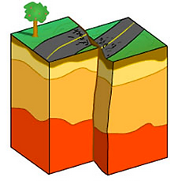
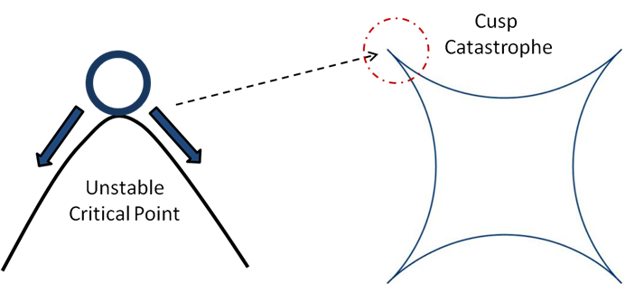

Catastrophic lens – why catastrophy?
„How the solutions to a system change as a parameter crosses critical values, leading to divisions into multiple parts.“
Everything is fine until a catastrophy happens
Not bullying others
Bullying others
Bullying others
Source: https://www.collegesidekick.com/study-guides/sac-earthscience/tectonic-forces
Catastrophic role of predictors leading to shifts in low/high bullying perpetration states
Not bullying others
Source: https://medium.com/science-spectrum/what-is-catastrophe-theory-cada83104a24

Slide 4
Previous literature
Healthy (order) and unhealthy (disorder) alternative stable states with a sudden transition between them under certain conditions (Dablander et al., 2023).
Continuous and sudden changes in temporal data of employee work enjoyment based on the level of task challenge and level of employee skill showing the flow vs. non-flow states of enjoyment could show sudden transitions (Ceja & Navarro, 2012).
When strong perceived psychological safety work climate (asymmetry), being victimized (bifurcation) → does not lead to bullying others (order variable).
BUT
When work climate perceived as unsafe, being slightly more victimized → trigger of a sudden shift to bully others (Escartín et al., 2013) – CCM „cusp R package“ used
Behavioral hysteresis (returning back to not bullying others – difficult)
Bullying perpetration (order parameter) can stay stable until thresholds in control parameters (asymmetry, bifurcation) are crossed

Slide 5
Current study, methods
Hypotheses: CCM fits better than linear model
Sample
Variables
Two-wave longitudinal study (February and June 2024)
18 schools, 119 classrooms, 1977 students, 1421 used (NA in scales averages omitted)
6th – 8th grades,
52% girls, data collected near Brno and surrounding areas,
9% immigrant background
Outcome: Bullying perpetration (individual level)
Asymmetry (direction of outcome potential):
moral disengagement (individual level, Killer et al., 2018),
externalizing behavior (individual level; Kelly et al., 2015),
being victimized (individual level; Walters et al., 2015)
Bifurcation (likelihood of sudden shift, small changes matter):
non-inclusive classroom norms (classroom level; Velásquez et al., 2023),
teacher support (classroom level),
social self-efficacy (individual level)

Slide 6
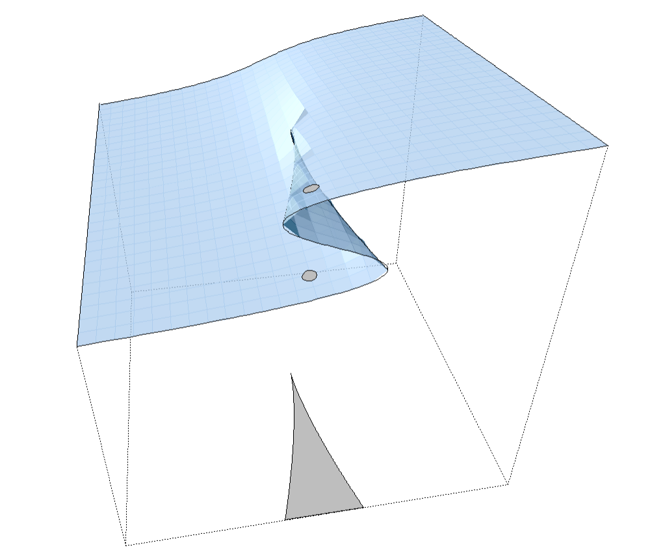
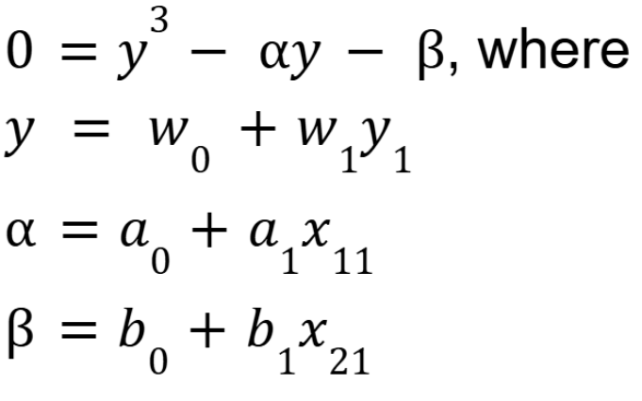
Formal model of CCM
Cusp point
Catastrophe theory (Thom, 1975) – small changes, sudden jumps
Asymmetry parameter (a) – direction of change
Bifurcation parameter (b) – gradual vs. sudden type of change (risk of instability)
Upper stable state
Bifurcation parameter b
Unstable middle
Lower stable state
State variable X
Asymmetry parameter a

Slide 7
Our model
Cusp point
e.g. Classrooms are more inclusive → kids who disengage morally, will bully more often
Bullying stable state
Non-inclusive norms +
Teacher support +
Social self-efficacy
Unstable
No bullying stable state
Bullying perpetration
Moral disengagement +
Externalizing behavior +
Bullying victimization
e.g. Classrooms are less inclusive → increasing level of moral disengagement does not increase bullying until a cusp point is met, then kids who disengage morally, will bully others (small changes matter around the cusp)

Slide 8
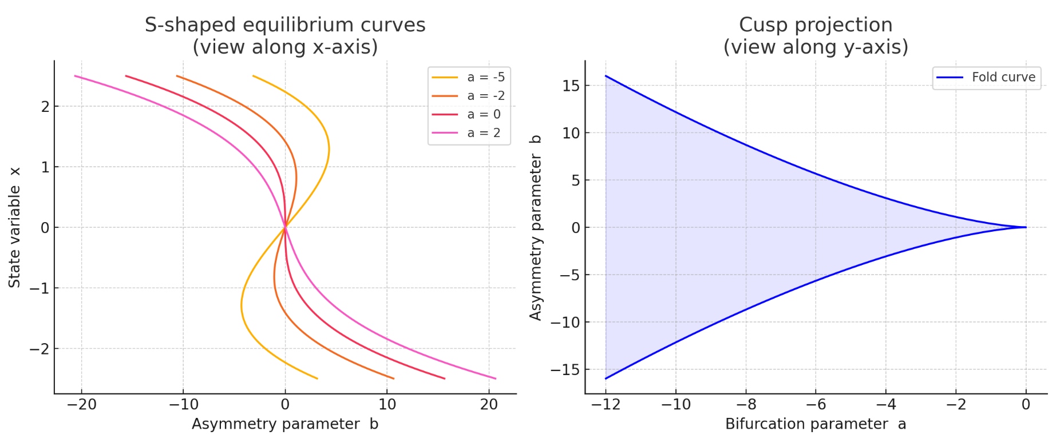
Formal model of CCM
b
b
b
b
a
b

Slide 9
Variable descriptives
Variable | M | SD | Mdn | Min | Max | Skew. | Kurt.
Bullying (T2) | 1.18 | 0.32 | 1.00 | 1 | 4 | 3.28 | 15.57
Moral disengagement | 2.23 | 0.85 | 2.12 | 1 | 6 | 0.95 | 1.32
Externalizing | 1.05 | 0.54 | 1.00 | 0 | 2.8 | 0.54 | 0.02
Non-inclusive norms (class) | 3.04 | 1.21 | 3.00 | 1 | 6 | 0.25 | -0.42
Victimization | 1.54 | 0.64 | 1.25 | 1 | 4 | 1.47 | 1.59
Social self-efficacy | 3.37 | 0.73 | 3.38 | 1.12 | 5 | -0-.31 | -0.21
Teacher support (class) | 3.45 | 0.87 | 3.50 | 1 | 5 | -0.40 | -0.20

Slide 10
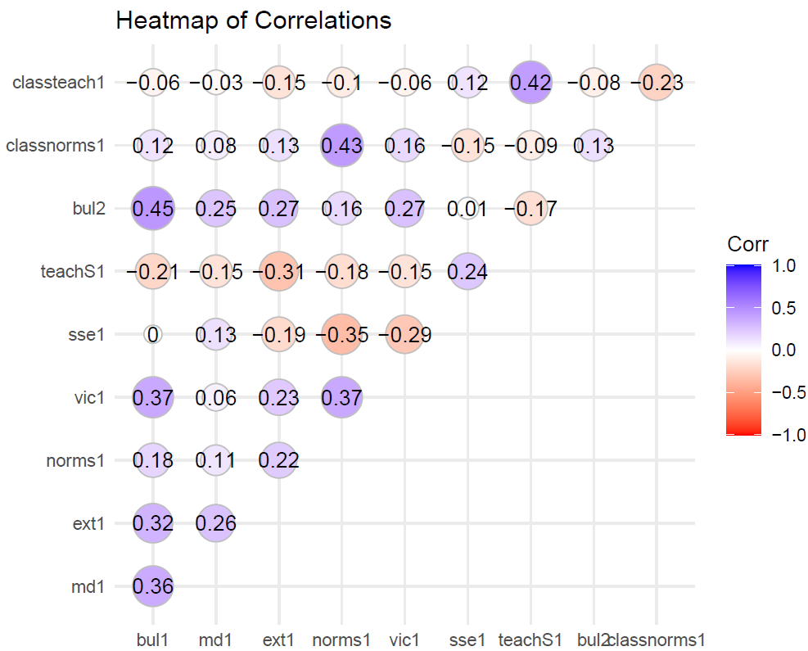
Variables bivariate correlations

Slide 11
Analysis: preliminary
OLS linear regression: F(6,1414) = 95.74,
p = 0.00, R² = 0.29, BIC = 3605.241, Intercept = 0
Cusp model (null): Cobb‘s pseudo R² = 0.40, BIC = 2963.639, Intercept = 0.62, w = -1.83
Linear: MoD: 0.28, p < .001
EXT: 0.19, p < .001
VIC: 0.34, p < .001
SSE: 0.11, p < .001
TeS: -0.01, p = .81
NiN: 0.03, p = .19
Asymmetry:
1. Alpha: -1.14, p < .001
Bifurcation:
1. Beta: 3.46, p < .001
Cusp model (full + class level): Cobb‘s pseudo R² = 0.41, BIC = 2541.067, Intercept = 0.61, w = -1.87
Cusp model (full): Cobb‘s pseudo R² = 0.44, BIC = 2584.621, Intercept = 0.61, w = -1.89
Asymmetry:
Intercept: -3.47, p < .001
MoD: 0.63, p < .001
EXT: 0.58, p < .001
VIC: 0.71, p < .001
Bifurcation:
Intercept: 2.35, p < .001
SSE: -0.11, p < .001
TeS*: 0.03, p < .001
NiN*: -0.10, p < .001
Asymmetry:
Intercept: -3.25, p < .001
MoD: 0.59, p < .001
EXT: 0.55, p < .001
VIC: 0.67, p < .001
Bifurcation:
Intercept: 2.55, p < .001
SSE: -0.14, p < .001
TeS: 0.13, p < .001
NiN: -0.11, p < .001
* = classroom level instead of individual level

Slide 12
Results
What makes students bully others more often?
If these are high, sudden escalations possible
If these are low, sudden escalations possible
Teacher support*
Moral disengagement
Social self-efficacy
Externalizing behavior
Being victimized
Non-inclusive
classroom norms*
* Class level of variables

Slide 13
Next steps?
Cobb‘s pseudo R² != R²
Not directly comparable (with linear model), especially for non-normal distributions
Only maximum likelihood used
Monte Carlo methods are more suitable to study the whole likelihood distribution of the parameters

Slide 14
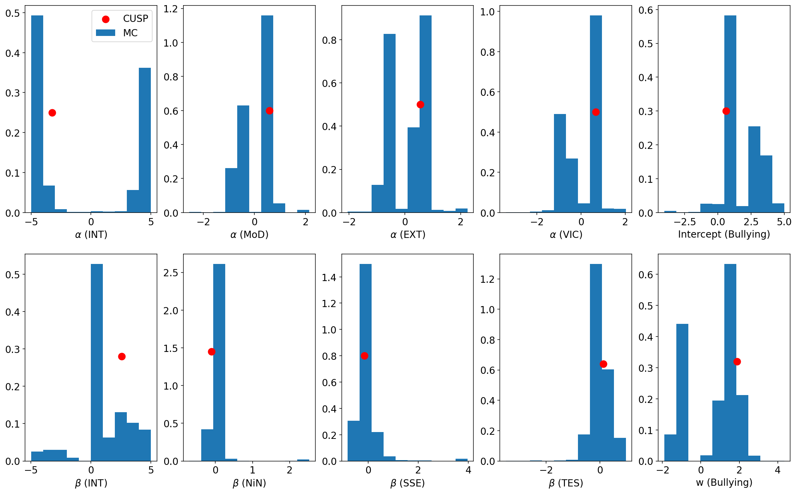
Monte Carlo modeling
Distribution of Model Parameters
CCM nonlinearity → not impossible to capture the distribution of the model parameters by a single model.
MC = probabilistic, more general approach based on random search through the parameter space.
Output = a range of models that fit the data well, instead of one best model (as in „cusp“ R package).
(A)symmetries in the CCM → two maxima in the distribution
After MC simulations, linear models fit better for the plausible parameter ranges

Slide 15

Closing…
The cusp model helps us see the tipping points and variables which can steer the eruption of bullying others.
Relying on maximum likelihoods may bias the results
Supported by the Moment of Change project (GA25-15697S).
Contact: Adam Klocek, klocek@psu.cas.cz
RG: https://www.researchgate.net/profile/Adam-Klocek
ORCID: 0000-0002-0797-4890

Slide 16
References
Chen, D. G., Gao, H., Ji, C., & Chen, X. (2021). Stochastic cusp catastrophe model and its Bayesian computations. Journal of Applied Statistics, 48(13-15), 2714-2733.
Carlo, C. M. (2004). Markov chain monte carlo and gibbs sampling. Lecture notes for EEB, 581(540), 3.
Ceja, L., & Navarro, J. (2012). ‘Suddenly I get into the zone’: Examining discontinuities and nonlinear changes in flow experiences at work. Human relations, 65(9), 1101-1127.
Dablander, F., Pichler, A., Cika, A., & Bacilieri, A. (2023). Anticipating critical transitions in psychological systems using early warning signals: Theoretical and practical considerations. Psychological Methods, 28(4), 765.
Escartín, J., Ceja, L., Navarro, J., & Zapf, D. (2013). Modeling workplace bullying behaviors using catastrophe theory. Nonlinear dynamics, psychology, and life sciences, 17(4), 493-515.
Grasman, R., van der Maas, H. L., & Wagenmakers, E. J. (2010). Fitting the cusp catastrophe in R: A cusp package primer. Journal of Statistical Software, 32, 1-27.
Killer, B., Bussey, K., Hawes, D. J., & Hunt, C. (2019). A meta‐analysis of the relationship between moral disengagement and bullying roles in youth. Aggressive behavior, 45(4), 450-462.
Kelly, E. V., Newton, N. C., Stapinski, L. A., Slade, T., Barrett, E. L., Conrod, P. J., & Teesson, M. (2015). Suicidality, internalizing problems and externalizing problems among adolescent bullies, victims and bully-victims. Preventive medicine, 73, 100-105.
Thom, R. (1975). Structural stability and morphogenesis. CRC press.
Walters, G. D. (2021). School-age bullying victimization and perpetration: A meta-analysis of prospective studies and research. Trauma, Violence, & Abuse, 22(5), 1129-1139.

Slide 17

Title title title title title title title title
Full name, affiliation

